Slide 1

AI-Powered Customer Segmentation
A comprehensive approach using RFM analysis, KMeans clustering, and machine learning to transform customer data into actionable insights. This solution enables businesses to identify distinct customer segments and deliver personalized marketing strategies at scale.

Slide 2

Business Context & Objectives
The Challenge
In today's data-rich business environment, companies struggle to transform customer data into actionable insights. Despite collecting vast amounts of transactional and behavioral data, many organizations fail to implement effective personalization strategies due to inadequate customer segmentation capabilities.
This gap between data collection and strategic action results in:
Generic marketing campaigns with low conversion rates
Missed opportunities for customer retention
Suboptimal revenue growth potential
1
2
3
Identify Distinct Customer Types
Provide AI-Backed Recommendations
Enable Interactive Simulation
Develop a segmentation system capable of automatically identifying valuable customer groups such as VIP users, dormant accounts, potential churners, and new customers based on their purchasing patterns and engagement history.
Support marketing decision-makers with intelligent, data-driven recommendations tailored to each customer segment, enabling more targeted campaigns and personalized communication strategies.
Create a flexible, user-friendly interface that allows business users to simulate segmentation for new or hypothetical customers, test different scenarios, and understand the driving factors behind segment assignment.

Slide 3
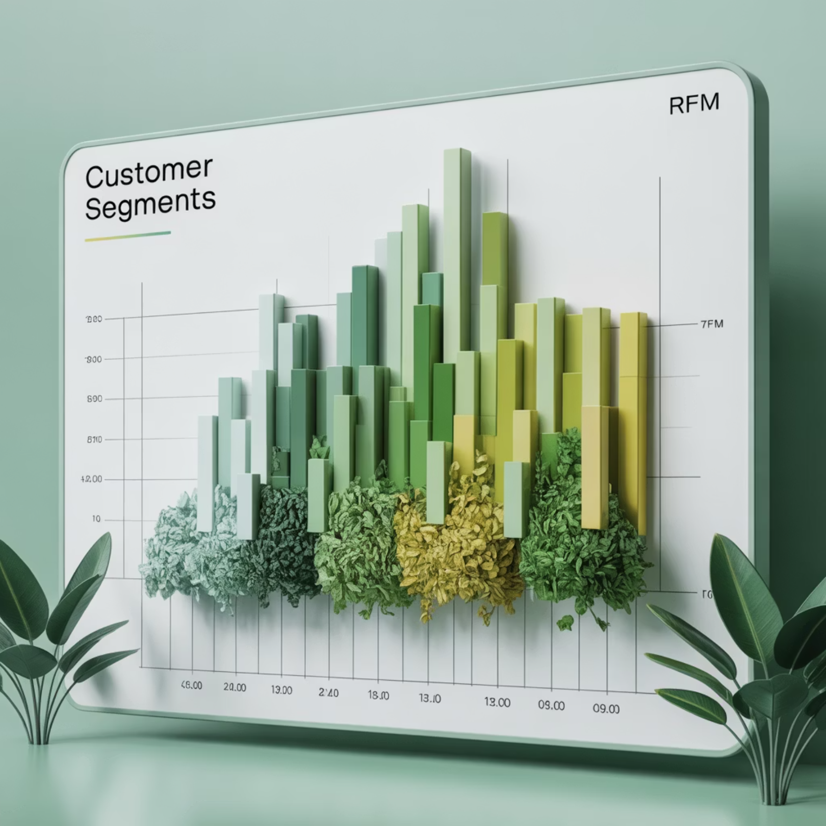
Dataset Description
Dataset Source
Attribute
Description
Usage
The dataset is sourced from Kaggle's "Customer Personality Analysis" collection, which provides a rich set of attributes about customer behavior, demographics, and transaction history. This dataset represents a typical customer database that might be available to marketing teams in retail or e-commerce businesses.
Recency
Days since last purchase
Core RFM metric
Frequency
Number of purchases made
Core RFM metric
Monetary
Total spending by customer
Core RFM metric
ID
Customer identifier
Tracking/filtering
Data Characteristics
Country
Geographic location
Segmentation grouping
The dataset includes thousands of customer records with complete transaction histories, allowing for comprehensive RFM analysis. The data spans multiple time periods, providing sufficient historical context for identifying patterns in customer behavior.
While the core segmentation relies primarily on the RFM metrics, additional demographic and categorical attributes enable more nuanced filtering and segment exploration in the final application.

Slide 4






Technical Stack
The customer segmentation solution leverages a modern data science and machine learning stack, carefully selected to provide robust analytics capabilities while maintaining flexibility and ease of deployment.
Python
Pandas & NumPy
Scikit-learn
Serves as the core programming language for the entire project, offering a rich ecosystem of data science libraries and tools. Python's versatility enables seamless integration between data processing, machine learning, and web application components.
Provides efficient data structures and operations for manipulating numerical tables and time series data. These libraries handle the heavy lifting for data cleaning, transformation, and feature engineering required for RFM analysis.
Implements machine learning algorithms including KMeans clustering, RandomForest classifiers, and PCA dimensionality reduction. This library also provides standardization and preprocessing tools essential for preparing data for modeling.
Streamlit
SHAP
LLM Integration
Powers the interactive web application frontend, allowing non-technical users to upload data, explore segmentation results, and receive AI-powered recommendations without writing code. Streamlit's rapid development capabilities enable quick iteration and deployment.
Delivers explainable AI capabilities by calculating feature importance and providing visual representations of how each feature impacts model predictions. This is crucial for helping business users understand the factors driving customer segmentation.
The application integrates with Groq's API to access Llama 3.3, a large language model that generates tailored marketing recommendations based on customer segments. This integration combines traditional clustering with modern generative AI capabilities.

Slide 5
Workflow & Methodology
The customer segmentation solution follows a systematic six-step workflow, combining traditional RFM analysis with advanced machine learning techniques and AI integration.
RFM Feature Engineering
1
Recency: Days since last purchase
Frequency: Total number of transactions
Monetary: Total spending value
2
Standardization & Dimensionality Reduction
StandardScaler for normalization
3
PCA with n_components=2
KMeans Clustering
2D visualization of customer clusters
Optimal k=4 via Elbow method
Segment identification
4
Meaningful segment labeling
Random Forest for Prediction
Supervised model training
5
Hyperparameter optimization
Explainability with SHAP
Real-time prediction integration
Feature importance calculation
Segment characteristic analysis
6
Transparent model decisions
AI Integration with Groq
LLM-powered recommendations
Segment-specific strategies
Actionable marketing insights

Slide 6

Key Outputs: Segment Profiles & Recommendations
High-Value Loyalists (15%)
RFM Profile: High Monetary (top quartile), High Frequency (>10 purchases), Low Recency (<30 days)
Actions: Implement VIP customer experiences, exclusive access to new products, personalized loyalty campaigns, and premium customer service.
At-Risk Customers (25%)
RFM Profile: Medium-High Monetary, Medium Frequency, High Recency (>90 days)
AI-Powered Marketing Recommendations
Actions: Deploy targeted reactivation campaigns with compelling offers, conduct win-back surveys, and create personalized re-engagement content.
"For Customer #4872 in Segment 1 (High-Value Loyalists): This customer's purchase frequency and monetary value place them in our top tier. Recommend creating a personalized anniversary email celebrating their one year as a customer with a special discount on premium products they've shown interest in but haven't purchased."
Occasional Buyers (42%)
"For Customer #3159 in Segment 2 (At-Risk): This customer hasn't made a purchase in 127 days despite previously being a regular buyer. Recommend an aggressive win-back campaign featuring products similar to their previous high-value purchases, coupled with a limited-time discount."
RFM Profile: Medium Monetary, Low Frequency (2-5 purchases), Medium Recency (30-90 days)
Actions: Develop frequency-based incentive programs, create compelling bundle offers, and implement targeted communication to establish regular purchasing patterns.
New Users (18%)
RFM Profile: Low Monetary, Low Frequency (1-2 purchases), Low Recency (<30 days)
Actions: Deploy comprehensive onboarding sequences, provide welcome incentives for second purchases, and implement educational content to build brand affinity.

Slide 7
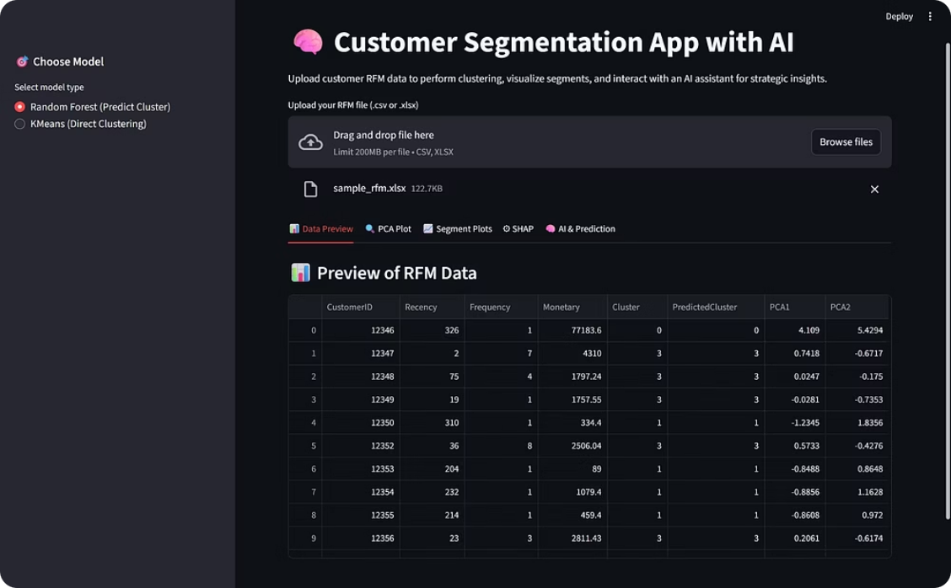
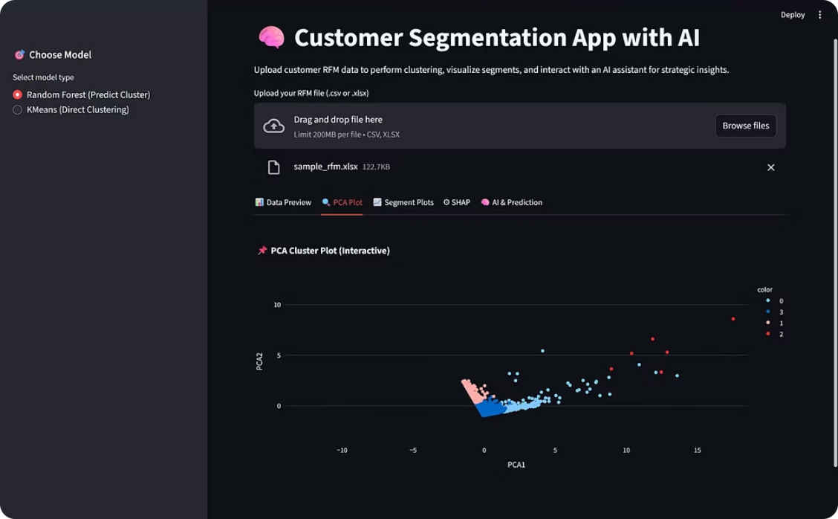
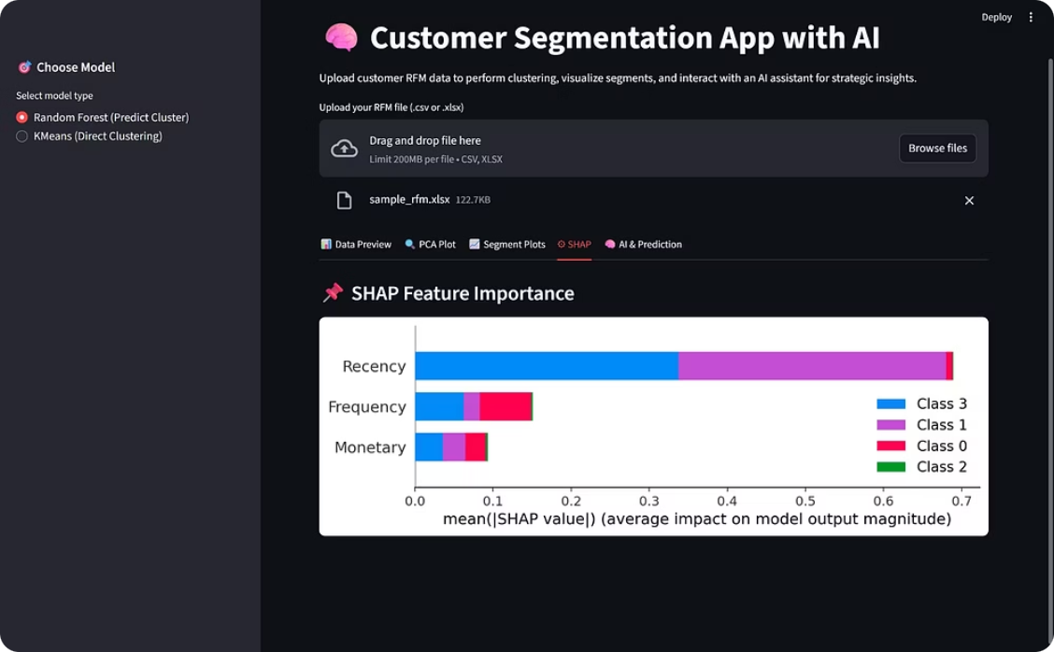
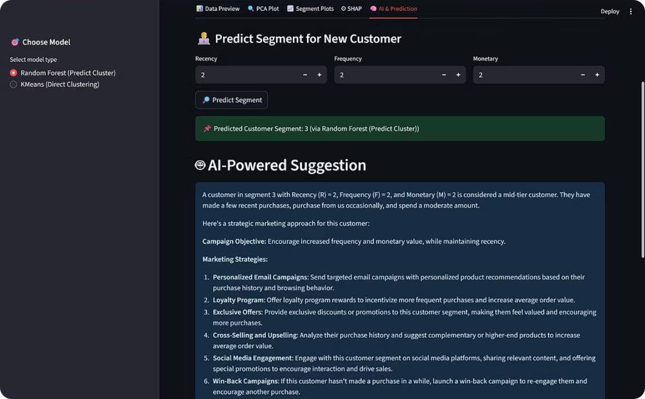
App UI Screenshots
Interface Showcase
The Streamlit application provides an intuitive, interactive interface for business users to upload customer data, explore segmentation results, and receive AI-powered recommendations.
Home & Upload Interface
PCA Visualization
The home screen provides a clear introduction to the application's capabilities and a simple drag-and-drop interface for uploading customer data files. Users can select additional parameters such as the number of clusters and feature scaling options.
The PCA visualization tab displays customer clusters in a two-dimensional space, allowing users to visually identify natural groupings and outliers. Interactive elements enable hovering over points to see individual customer details.
SHAP Feature Importance
AI Recommendation Panel
The explainability tab presents SHAP values in an intuitive bar chart format, helping users understand which features have the greatest impact on segment assignment. This transparency builds trust in the model.
The AI recommendation panel leverages LLM technology to generate specific marketing suggestions for each customer segment. Users can select individual customers or entire segments to receive tailored recommendations.

Slide 8



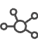
Future Enhancements
While the current version of the customer segmentation application provides robust functionality, several enhancements are planned to expand its capabilities and improve user experience.
Database Integration
Multi-User Authentication
Implement persistent database connections to store segmentation results and customer query history. This would enable tracking of customer segment migrations over time and provide historical context for analysis.
Implement a robust authentication system to support multiple user accounts with different permission levels. This would enable team collaboration while maintaining appropriate access controls for sensitive customer data.
Export Functionality
Advanced Segmentation Models
Add comprehensive export options including CSV download of prediction logs, segment summaries, and AI recommendations. Enable direct integration with popular marketing platforms through API connections.
Expand beyond RFM analysis to incorporate additional segmentation techniques such as behavioral clustering, predictive lifetime value modeling, and churn prediction. This would provide more nuanced customer insights.
Enhancement
Priority
Complexity
Timeline
API for external system integration
High
Medium
Q3 2023
Custom segment definition tools
Medium
High
Q4 2023
Advanced visualization options
Medium
Medium
Q3 2023
Multi-model ensemble approach
Low
High
Q1 2024

Slide 9
Conclusion
The AI-Powered Customer Segmentation system successfully addresses a critical business challenge by transforming raw customer data into actionable marketing insights. By combining traditional RFM analysis with advanced machine learning techniques and modern AI capabilities, the solution provides a comprehensive framework for understanding customer behavior and optimizing engagement strategies.
4
95%
85%
3X
Customer Segments
Prediction Accuracy
Variance Explained
Campaign Efficiency
Distinct, actionable customer groups identified through RFM analysis and KMeans clustering
High confidence in segment assignment for new customers using Random Forest classifier
Percentage of data variance captured by the PCA dimensionality reduction
Potential improvement in marketing campaign efficiency through targeted segmentation
Key Achievements
Interpretable Segmentation
Scalable Architecture
AI-Enhanced Strategy
The solution provides clear, business-friendly segment definitions that marketers can easily understand and act upon. The explainability layer ensures transparency in how customers are assigned to segments.
The technical implementation scales effectively to handle large customer datasets while maintaining reasonable processing times. The application architecture supports future enhancements without requiring significant refactoring.
The integration of LLM-powered recommendations adds a layer of strategic guidance that goes beyond simple segmentation, helping marketers develop targeted approaches for each customer group.

Slide 10
Author & Project Resources
About the Author
Project Resources
Sarath Sai Sujith Srinivas Grandhe
Explore the project's codebase and see the application in action:
Aspiring Business Analyst | Data Analyst | Data Engineer
GitHub Profile: https://github.com/Sarathsai4
Graduate Student – MS in Business Analytics, University of Cincinnati
Repository: Customer Segmentation App Repository
Contact: grandhss@mail.uc.edu | sarathsai.grandhe@gmail.com
Key Interests
Technical Skills
Data-driven decision making
Cloud-based analytics solutions
Languages & Libraries
Process optimization and automation
Python, R, SQL, MATLAB, TensorFlow, PyTorch, Pandas, NumPy, scikit-learn
Customer behavior analysis
AI integration in business applications
Cloud & Data Engineering
AWS (S3, Redshift, Glue, EC2), Apache Spark, Airflow, Terraform, dbt, PySpark
Databases & ETL
PostgreSQL, BigQuery, SQLAlchemy, KNIME

